Slide 1

Indiana Regional Office
Notes:
Introduction of myself, Ann and what we do. New office since Jan 2018. Thanks for the invitation to present.

Slide 2

Mission Statement:
The Society of St. Andrew brings people together to harvest and share healthy food, reduce food waste, and build caring communities by offering nourishment to hungry neighbors.

Slide 3
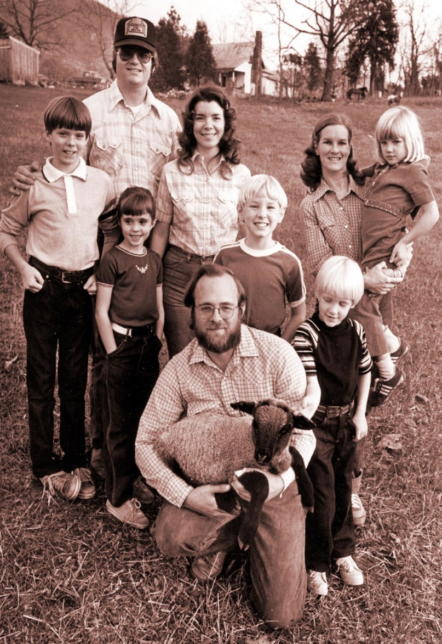
History
Founded in 1979 in Big Island, Virginia SoSA moved the first load of potatoes in 1983.
Since then SoSA has established 8 regional offices and has saved over 873 million pounds of food!

Slide 4
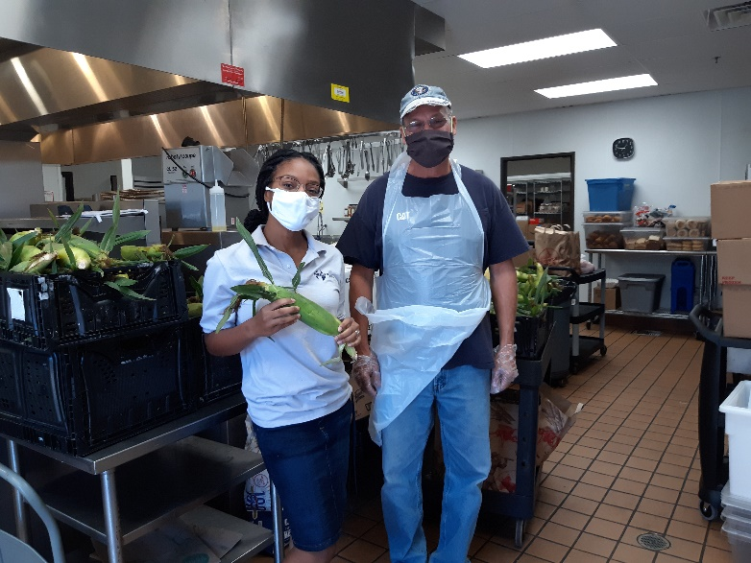
There are over 37 million people who are food insecure in the United States!
Indiana:
13.2% are food insecure
883,260 individuals
274,080 are children (17.5%)
(2018 stats from www.map.feedingamerica.org)
There is enough wasted produce to feed everyone in the United States so that no one has to go hungry!
Notes:
In St. Joseph County there is 14.1% food insecurity rate. In Hamilton Co. there is 8.8% food insecurity rate and 4.8% poverty rate. In Marion Co. there’s 18.6% food insecurity and 18.9% poverty rate. Vanderburgh Co. food insecurity rate is: 15.4% but 19.3% for Children. Poverty rate is 17.4% and 22.8% for children.

Slide 5
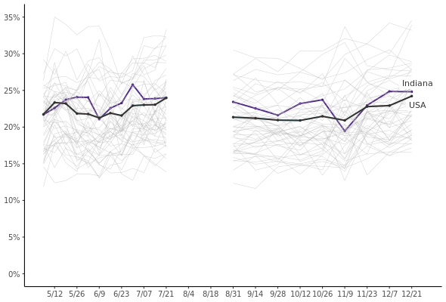
What happened to Food Insecurity during COVID?
Currently, Indiana’s food insecurity rate is 24.8%!!
From Northwestern University 1/15/21 data:
https://www.ipr.northwestern.edu/state-food-insecurity.html#.Xw4hw0FRHK0.email
Notes:
Dark green shows the highest rates of food insecurity in IN. Marion county has the highest food insecurity rate in IN at 18.6%, then Monroe 17.6% and then Vigo 16.9%.
Monroe has the higheset poverty rate – 21.6%, then Switzerland 20.1 and Delaware 19.4.

Slide 6
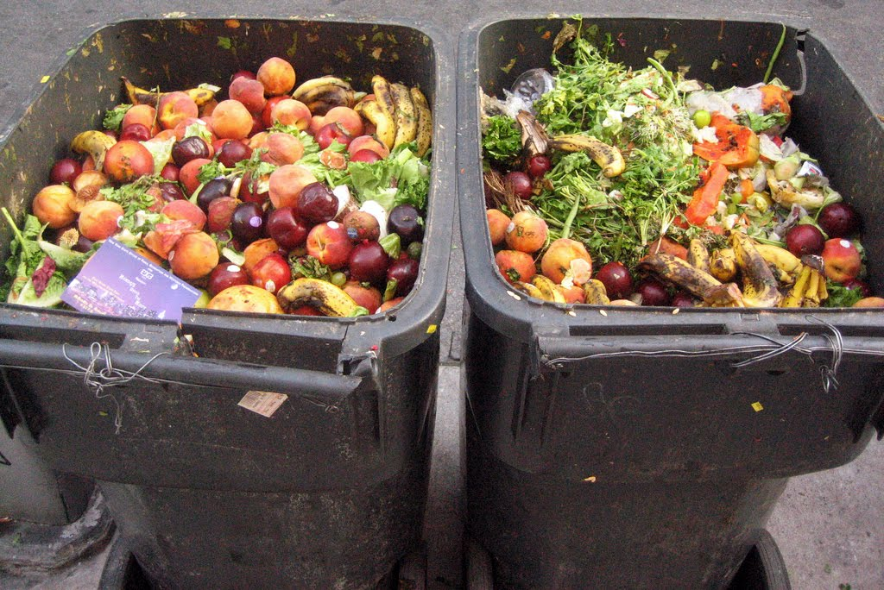
And there is an enormous amount of Food Waste in the U.S….
Food waste is the 2nd largest contributor to methane gas pollution. 103 million tons or 206 billion pounds of food are wasted each here in the U.S. Every ton of food waste = driving a car for a year in emissions.
40% of our food never makes it to market
Reasons for waste: cosmetically imperfect, farmer produced too much, delivery refused, crop not sold, too ripe, or u-pick farms closed for season
https://www.epa.gov/sites/production/files/2020-11/documents/2018_wasted_food_report-11-9-20_final_.pdf

Slide 7
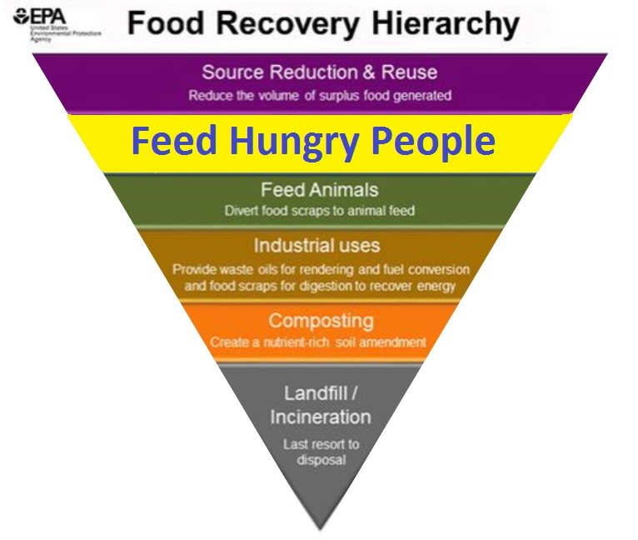
SO EXISTING FOOD MEETS ITS BEST POSSIBLE USE ->
Our planet will soon be home to 9
billion people, all of whom will need
healthy food to eat;
There are hungry people today—not just
across the world, but across the street!
Tremendous human and natural resources go
into producing food. When it is not eaten, those
resources are wasted.
Huge financial loss results all along the production
and distribution chain—and at the household level—
when food goes to waste.
Somewhere along the line, food that goes to waste is left
to rot, often in a landfill, where it produces significant quantities of harmful methane gas

Slide 8
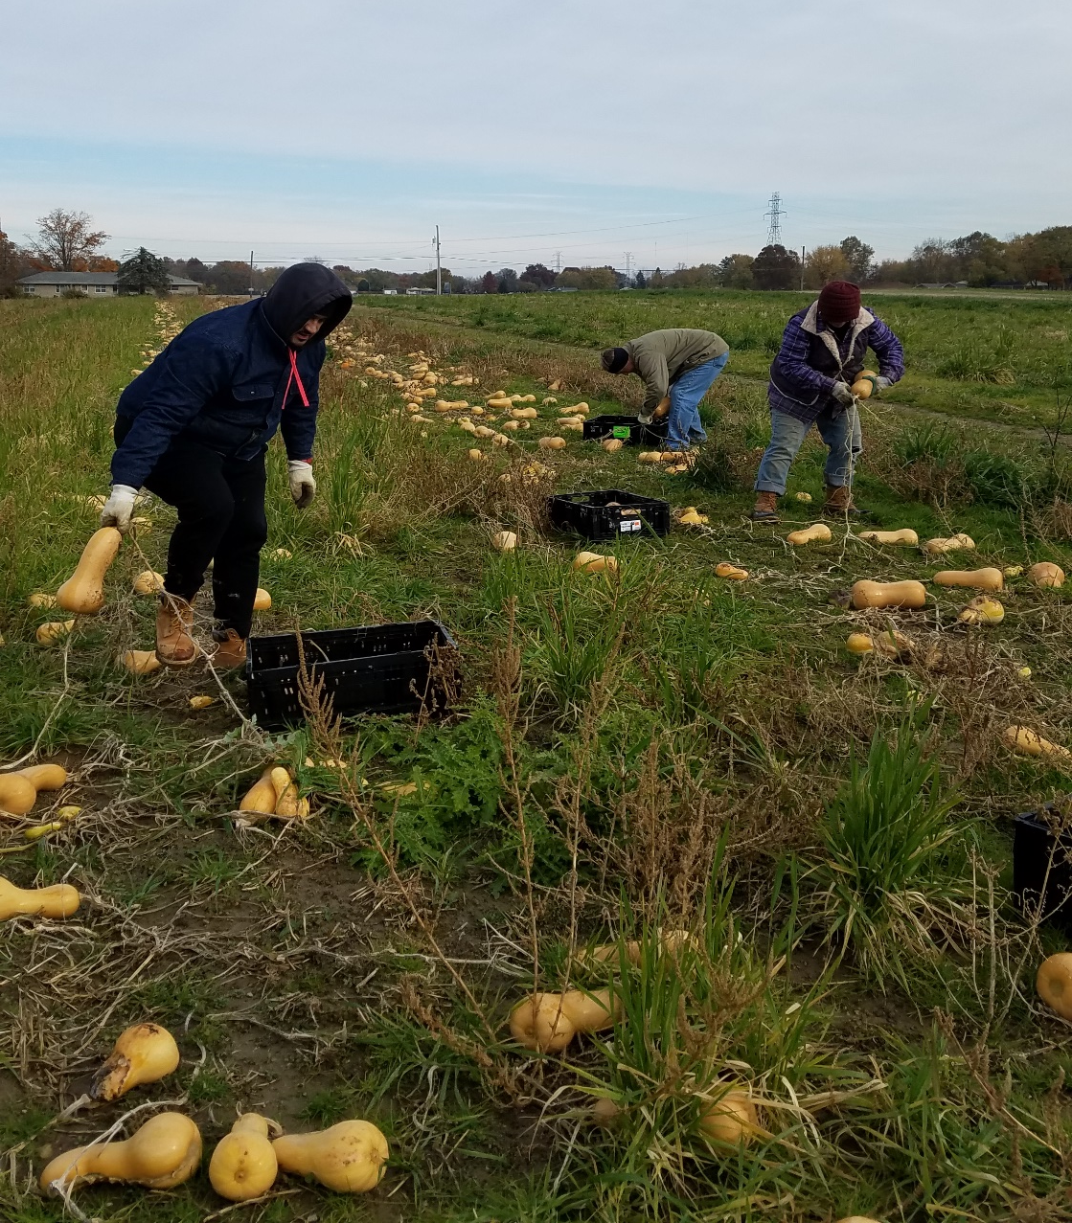
So…..what does gleaning have to do with all of this??

Slide 9
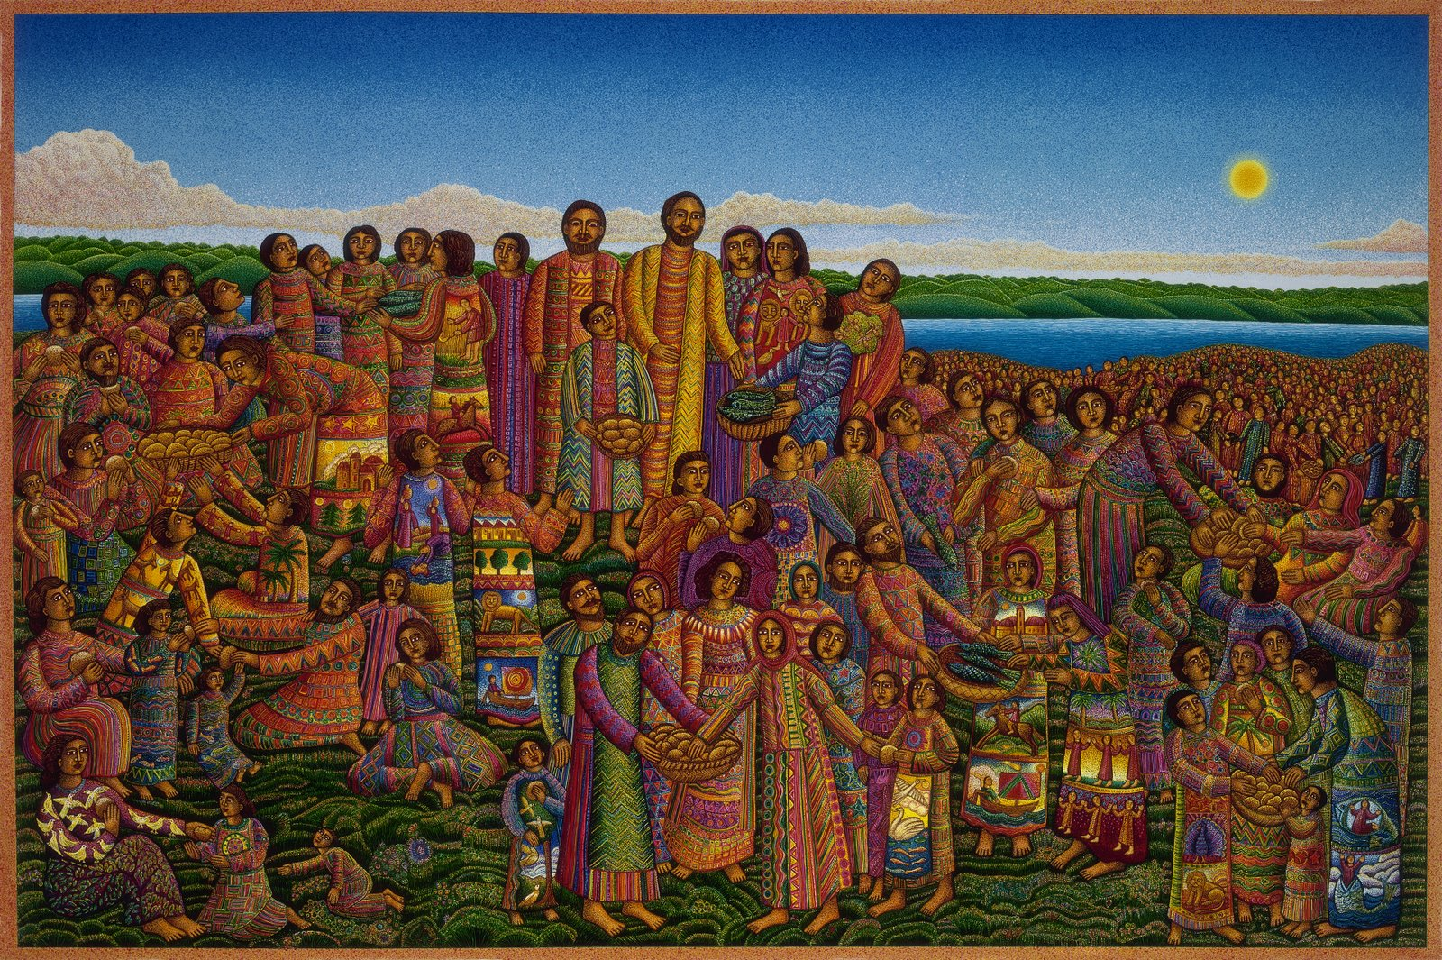
hIt’s all about sharing the abundance…..
John 6:12
When they were full, Jesus told his disciples, "Collect the leftovers so that nothing is wasted."
It’s all about sharing abundance...
Feeding of the 5,000, John August Swanson

Slide 10
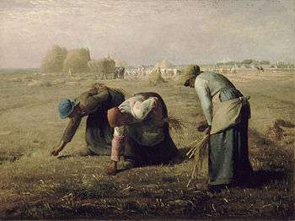
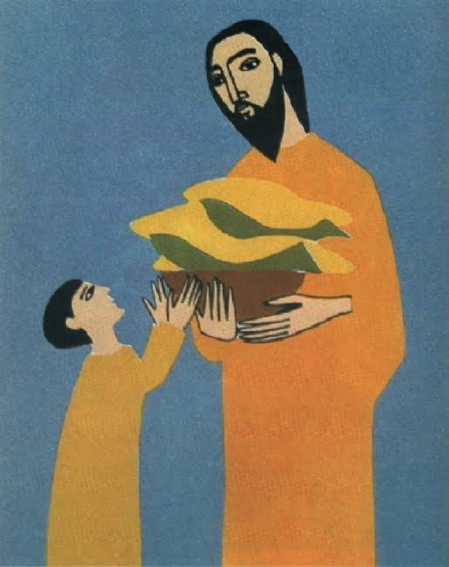
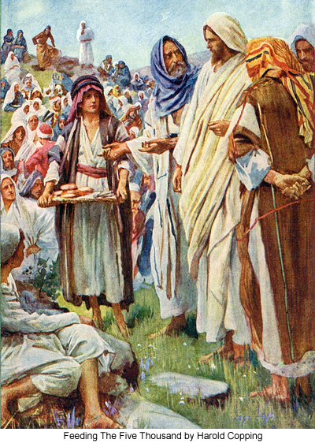

Where does the name Society of St. Andrew come from?
What is gleaning?
John 6:1-14
Glean – (from dictionary.com)
verb (used with object)
1. to gather slowly and laboriously, bit by bit.
2. to gather (grain or the like) after the reapers or regular gatherers.
3. to learn, discover, or find out, usually little by little or slowly.
The SoSA Shield
St. Andrew’s Cross
Trefoil symbolizes Christian spiritual life
Fish symbolize Christian community
Wheat symbolizes ministry to the physically and spiritually hungry
Stump symbolizes church renewal
Lev 19:9-10, 23:22
Ruth 2:2-3,15-23
Deuteronomy 24:19-22
-for the orphan, widow, foreigner, poor

Slide 11
Local Farmers
fields · packing houses · farmers markets
Local Volunteers
all ages · all walks of life
Local Hungry People
receive fresh, healthy food
often the same day it was gleaned
Local Feeding Agencies
food banks · food pantries · shelters
soup kitchens · Title I schools
senior | child | disaster | emergency | etc.

Slide 12

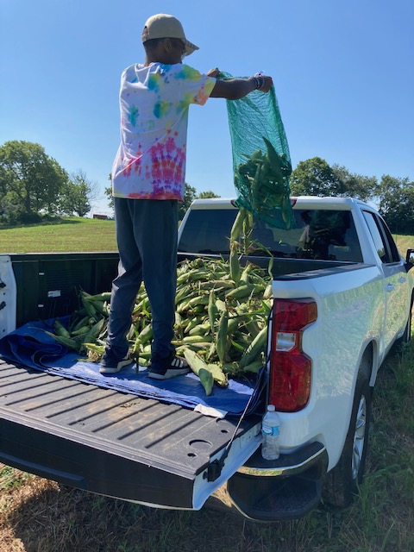
Gleaning can look different than it did back in the day. It’s still relevant in 2021 and can happen in all sorts of places!
  Farmers Markets
  In the Field
  In Parking Lots
  From a Dock
Farmers’ Benefit from Gleaning
Volunteers Learn, Work Hard, Have Fun and Help Those Who are Food Insecure
Donors Make it Possible!

Slide 13
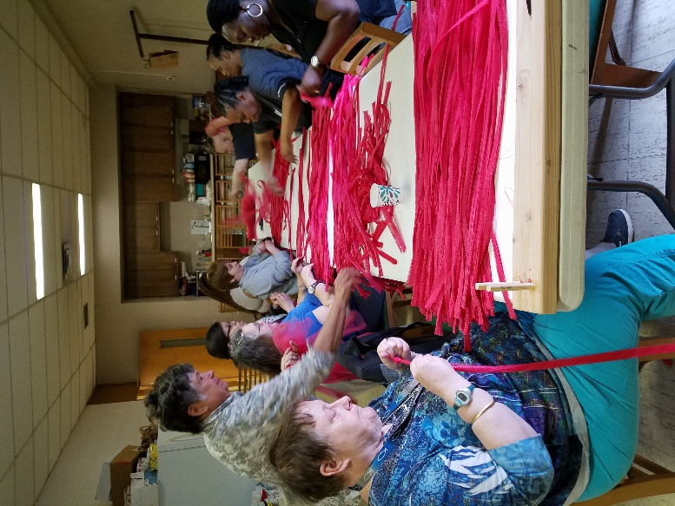
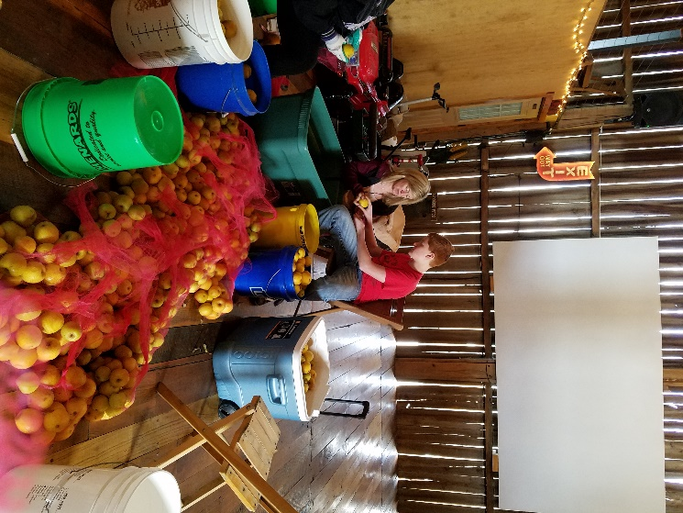
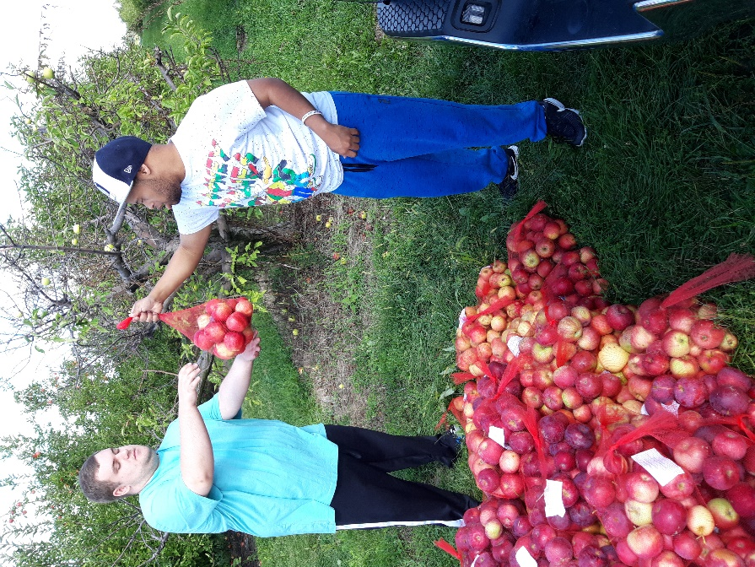
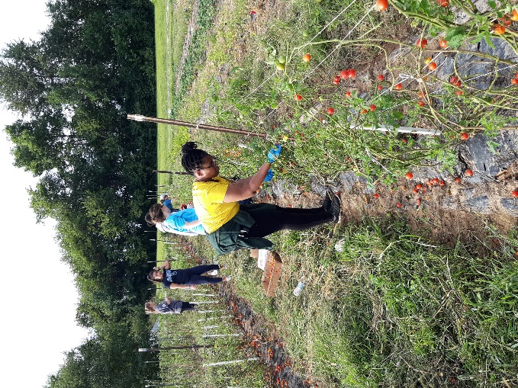
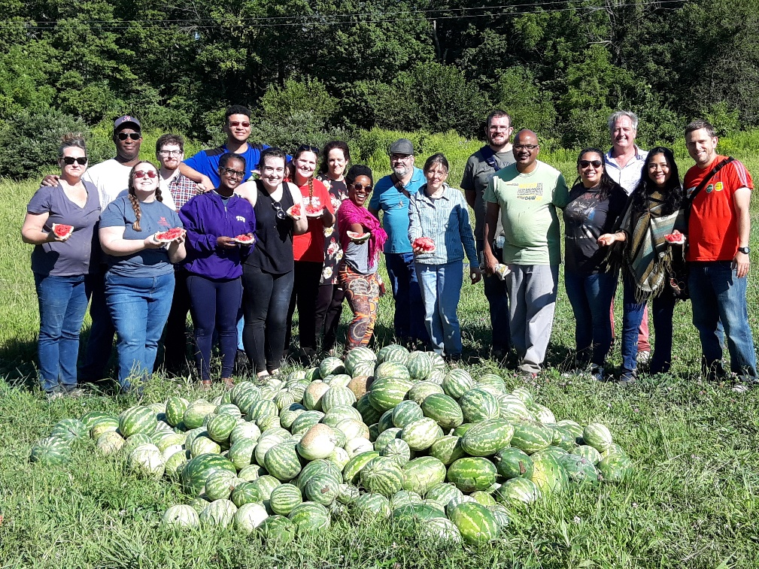
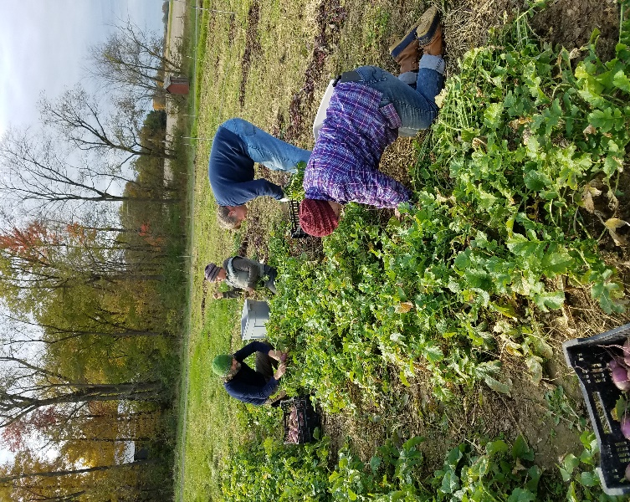
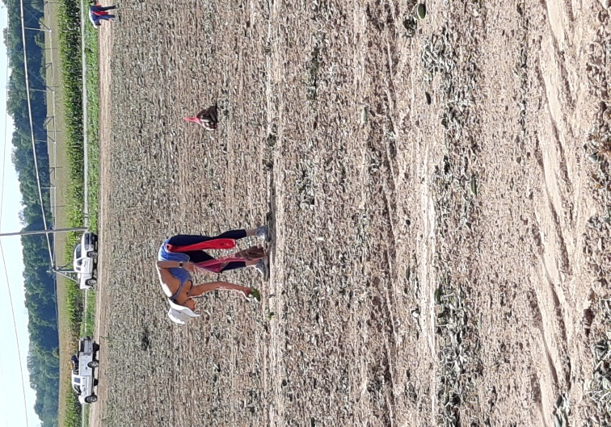
Gleaning
Notes:
Our gleanings look a bit like this but vary from place to place and farm to farm. We glean 12 pounds of lettuce to 100 acre cucumber farms!

Slide 14
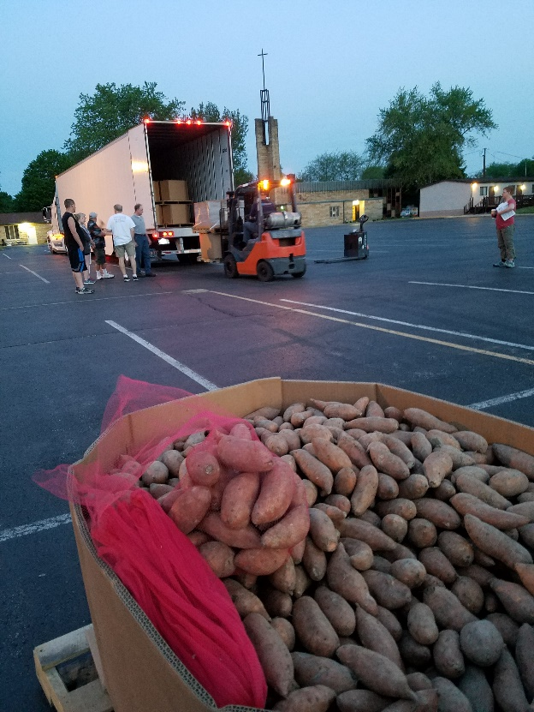
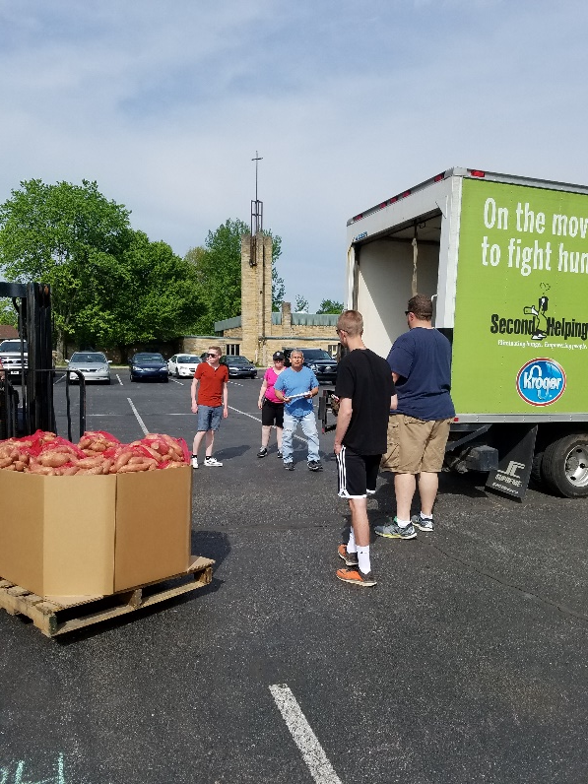
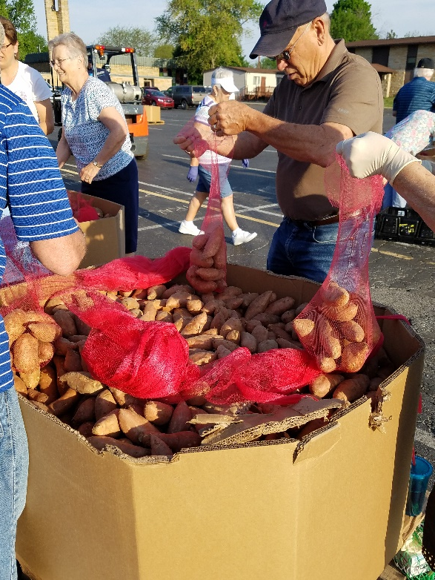
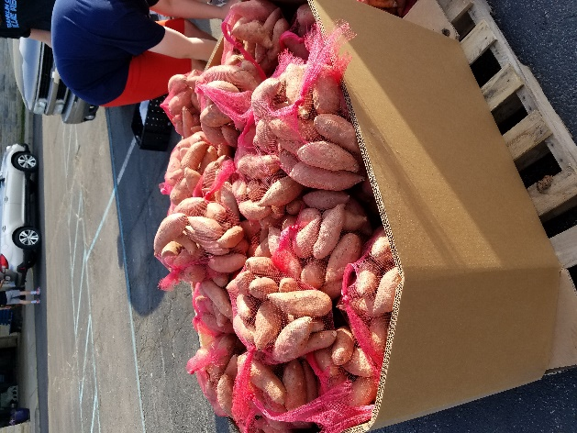
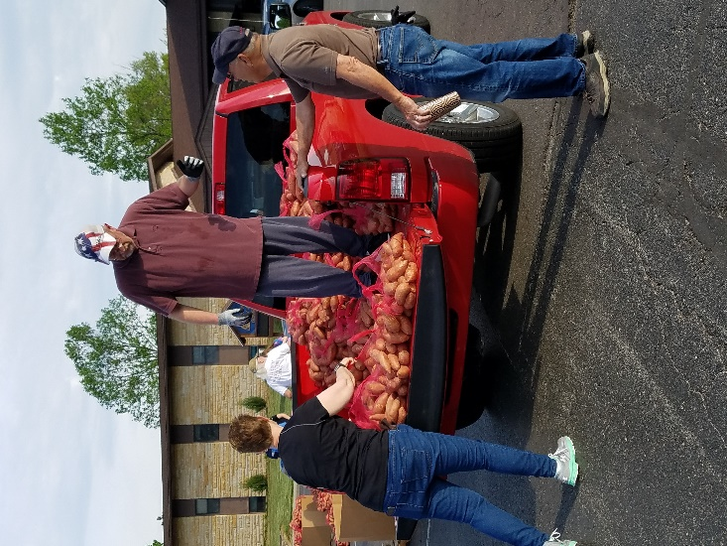
Produce Drops
Notes:
Mostly potatoes here in IN. 40,000 pounds show up and are distributed in same day.

Slide 15
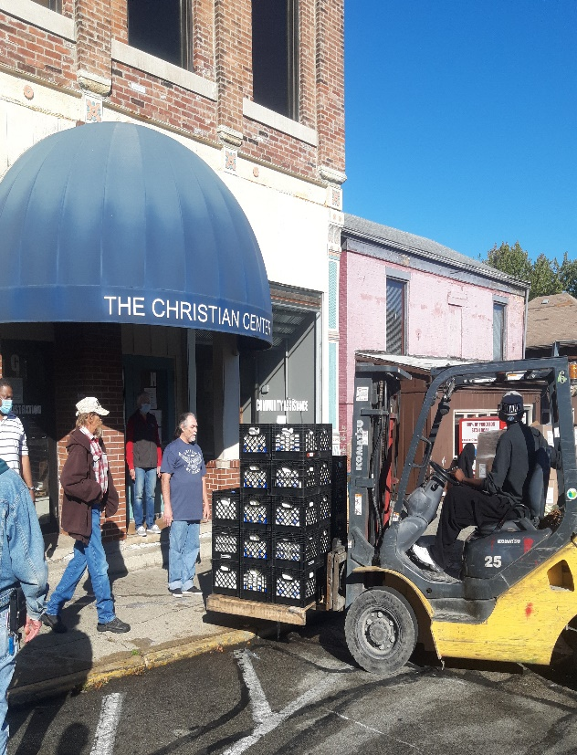
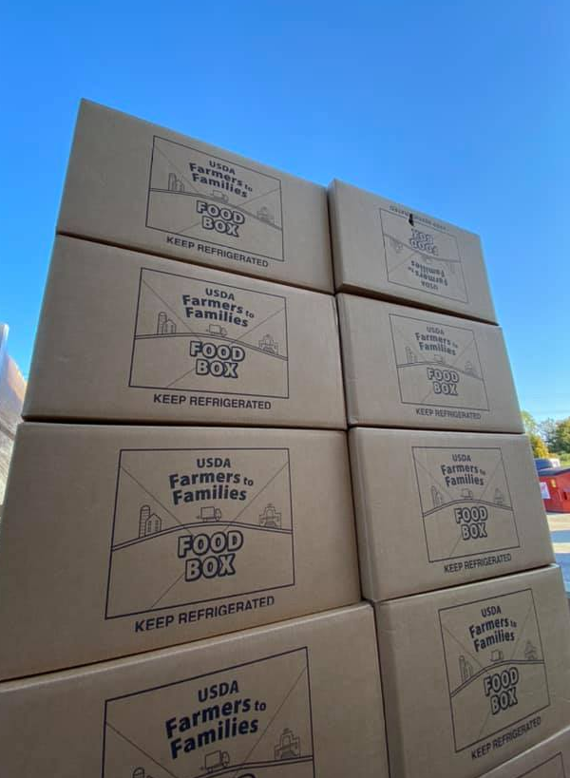
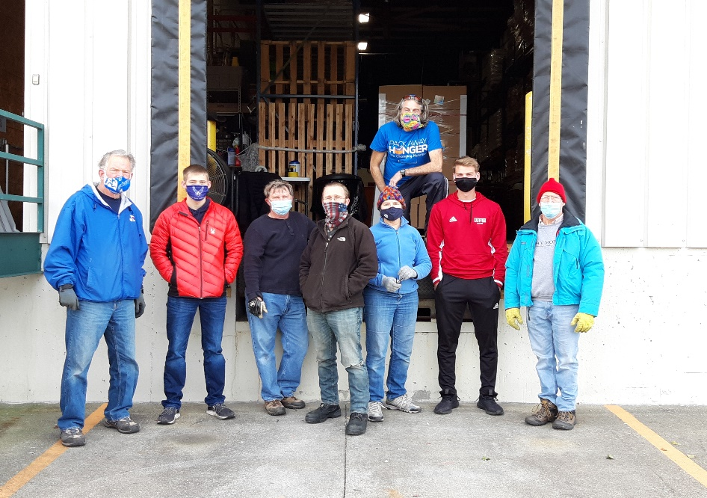
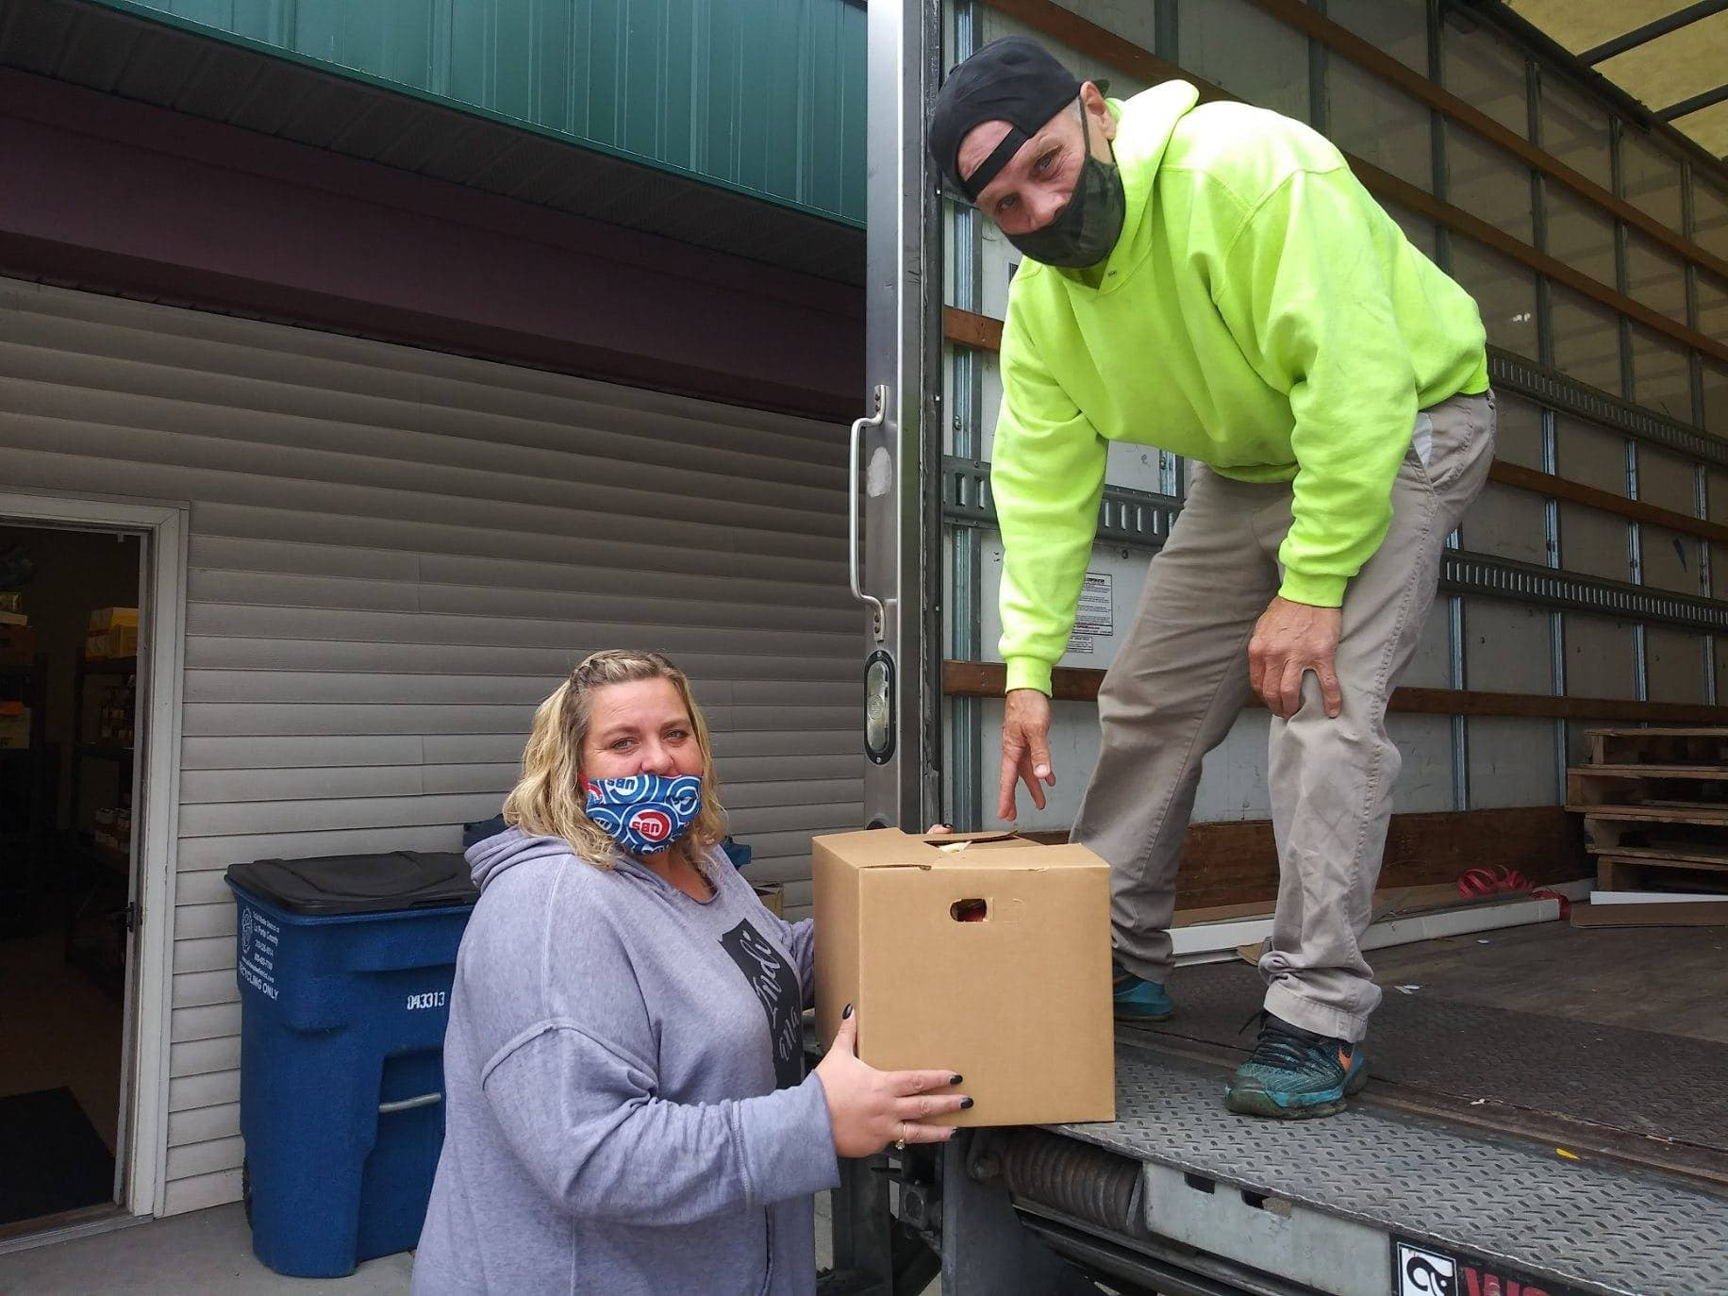
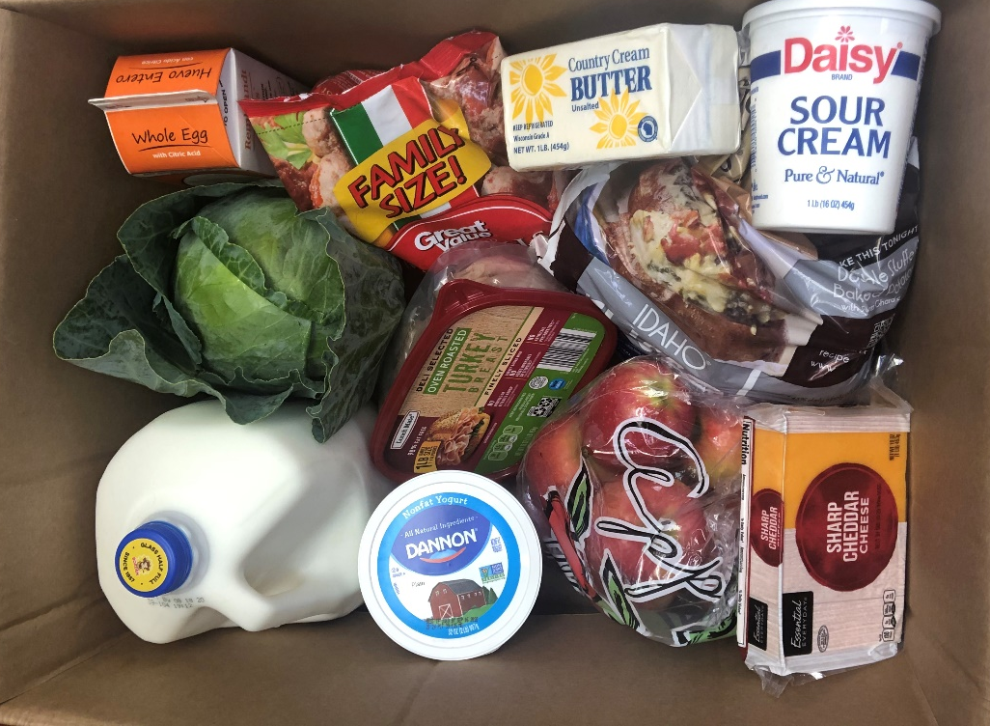
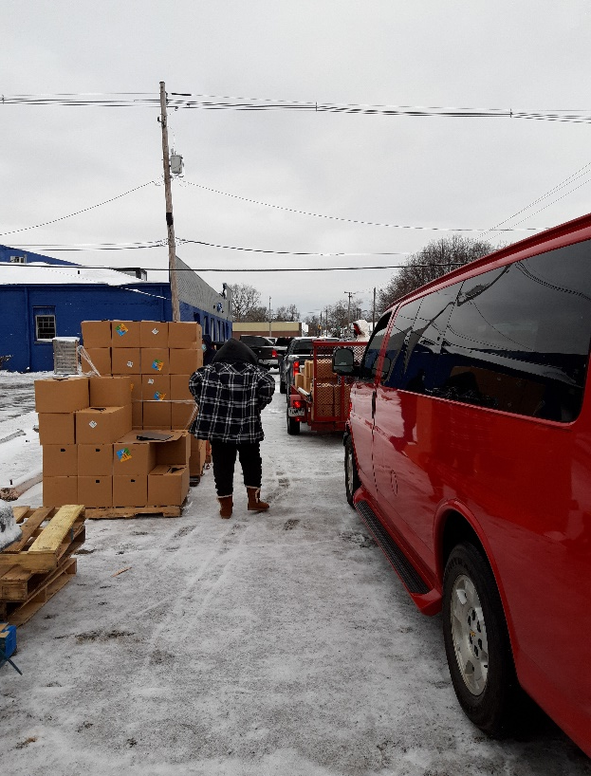
2020 Farm to Family Food Boxes

Slide 16
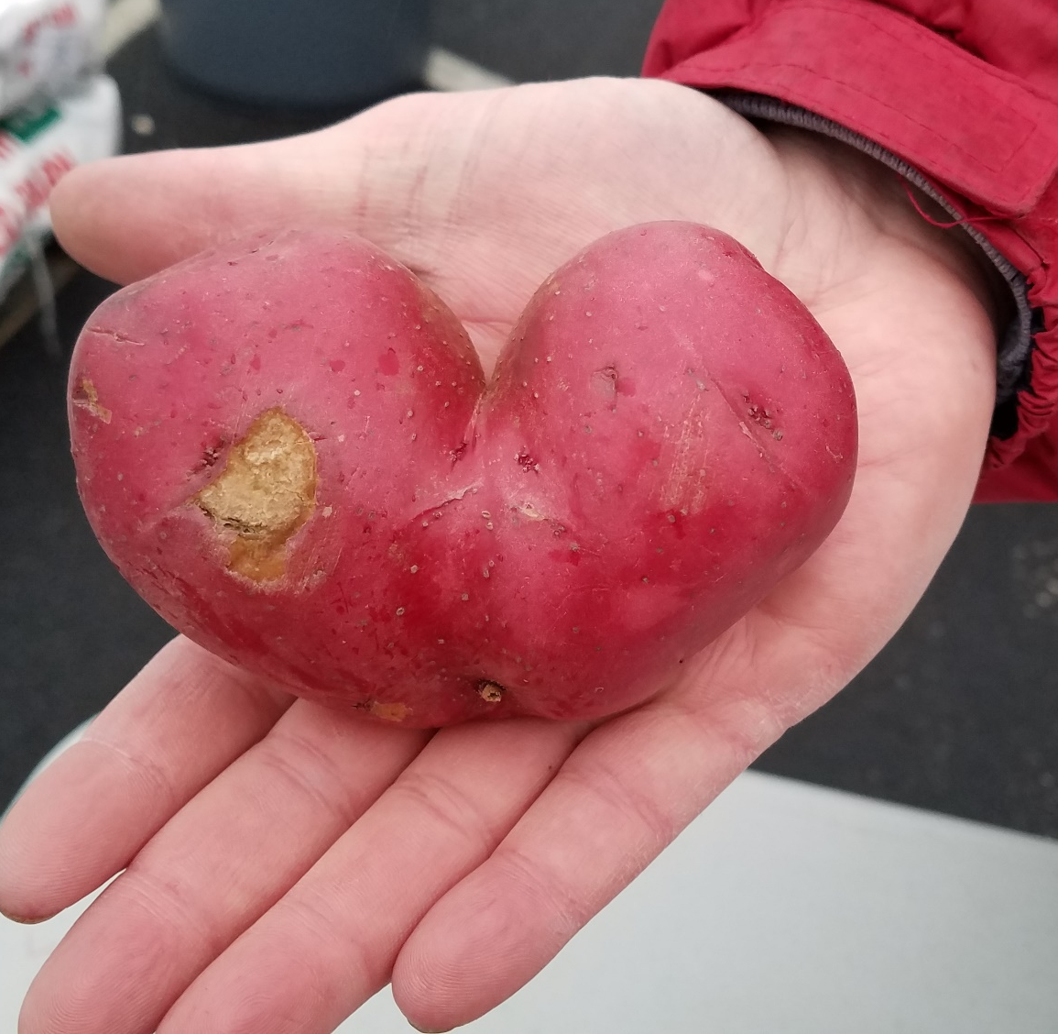
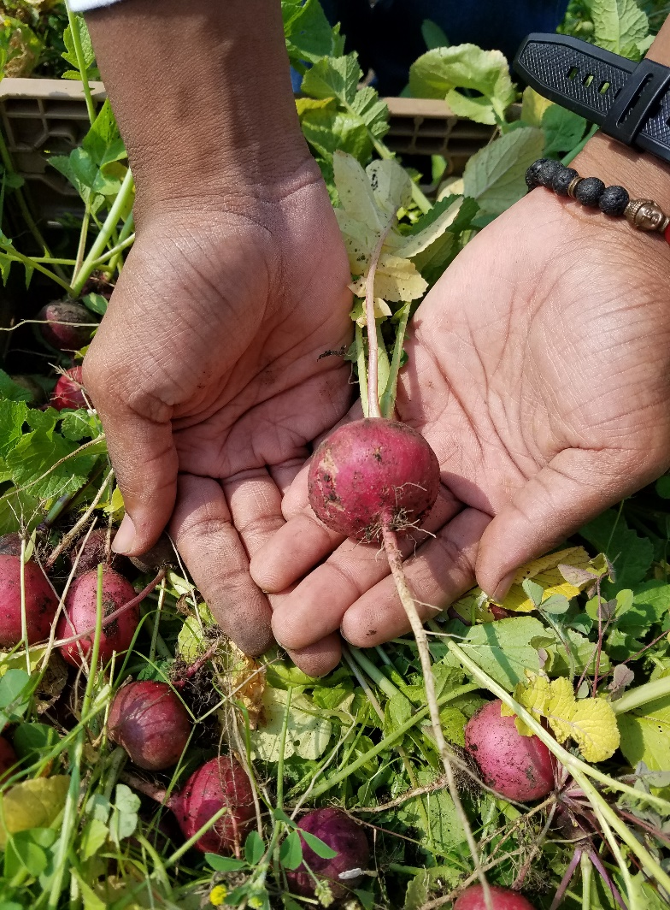
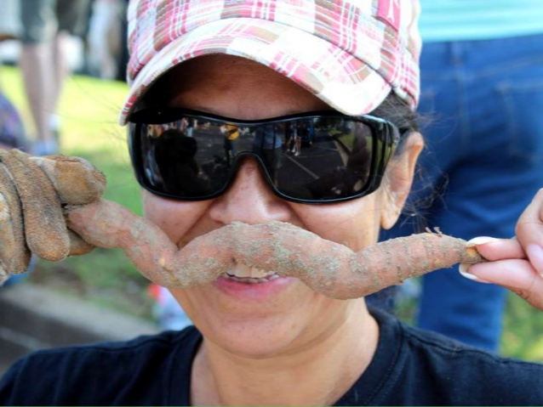
Notes:
And I say, when we glean together, we have fun together!!! Gleaning also provides the opportunity for people, especially our children, to see where their food comes from, it opens doors of education around nutrition (sharing recipes and stories about food and family), and it provides fresh air and sunshine and physical activity that makes us all healthier and happier!

Slide 17

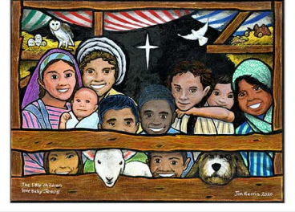


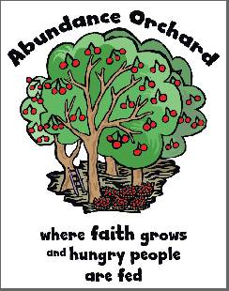



SoSA Faith Based Resources

Slide 18
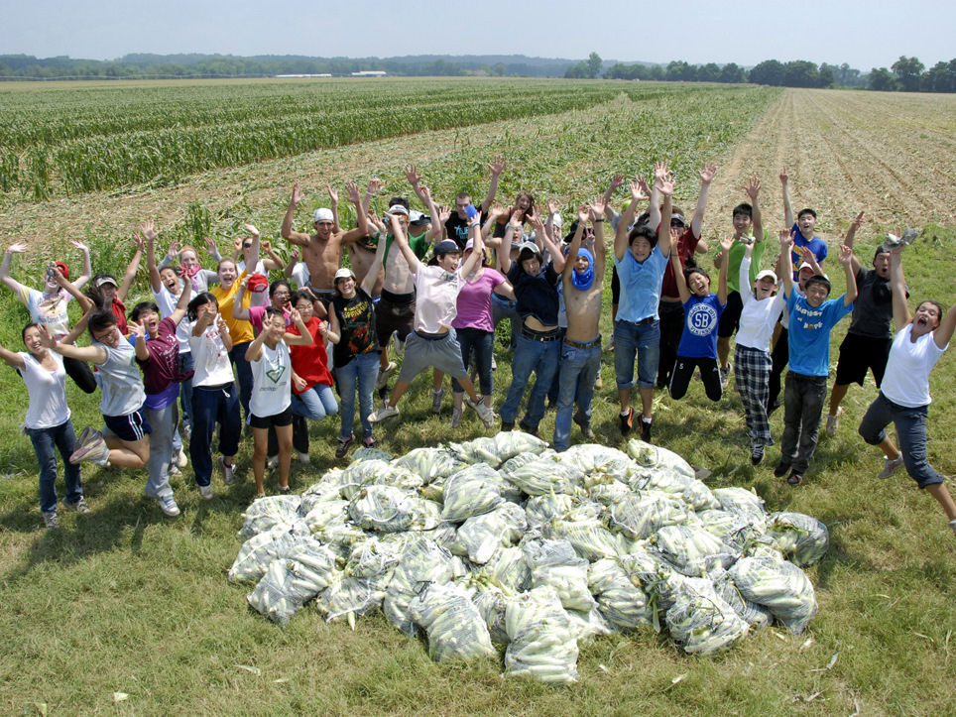
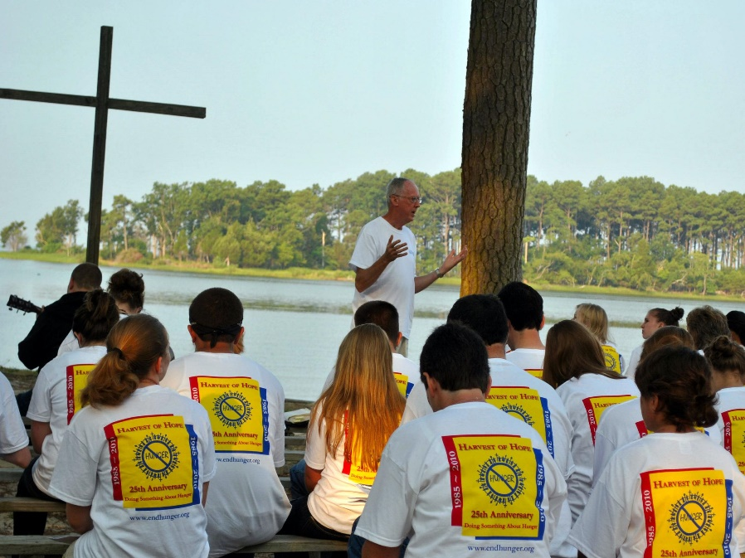
Harvest of Hope

Slide 19
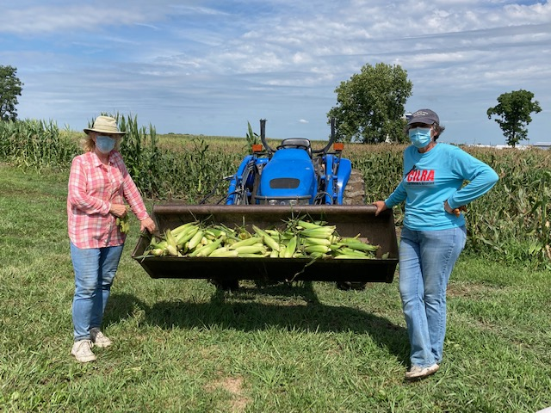
Support Society of St. Andrew by Getting Involved!
Connect us to a farmer
Volunteer to glean with us
Connect us to a hunger relief agency
Host a Produce Drop or Farm to Family Distribution
Donate to us – All Indiana $ stays in Indiana
Notes:
So how can you help and how can we partner together? Go through the list.

Slide 20

Contact Information
Dawn Barnes
Indiana Regional Director
indiana@endhunger.org
317.279.5119
Ann Radtke
Indiana Program Coordinator
in-glean@endhunger.org
317.607.0004
Sue Plummer
Tri-State Program Coordinator
sw-ohio@endhunger.org
513.206.0350
Notes:
Thank you for the opportunity to meet and talk today. Thank you for the work that each of you do and I look forward to ways we can partner together.

