Slide 1
HOUSEKEEPING & HOSPITALITY
A portion of today’s meeting will be recorded and archived for Provincial record keeping
Please mute your mic unless addressing the body
We encourage you to keep your video on
Use the chat feature to share ideas or questions.
Use the “raised hand” icon to be recognized to speak
Use #ProvVSynod to share your excitement!

Slide 2
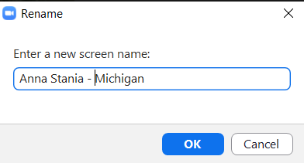
IDENTIFY YOUR DIOCESE
Take a moment to:
Right-click on your name in your Zoom box and select “RENAME” from the menu

Slide 3
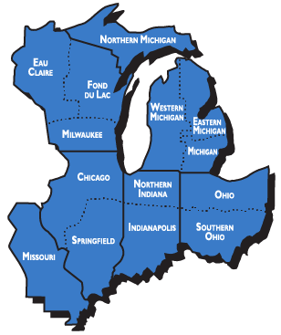
WHAT DOES THE PROVINCE DO?
The purpose of Province V:
To connect people to one another
To build networks of ministers
To support each other in their local ministries

Slide 4
PROVINCE V EXECUTIVE BOARD
REPRESENTATIVE DIOCESE
The Rev. Fran Holliday Chicago Ms. Katie Forsyth Eastern Michigan OPEN SEAT Eau Claire Mr. David Annis Fond du Lac Ms. Lesley MacKellar Indianapolis Ms. Anna Stania Michigan The Rev. Matt Buterbaugh Milwaukee Ms. Betty Bowersox Missouri Mr. Christopher Hillak Northern Indiana Mr. Rick Stanitis Northern Michigan The Rev. Aaron Gerlach Ohio Mr. Edward Lasseigne Southern Ohio Ms. Jan Goossens Springfield The Rev. Joel Turmo Western Michigan
ELECTED OFFICIALS
PRESIDENT
The Rt. Rev. Mark Hollingsworth - Ohio
VICE PRESIDENT
Canon Jane Cisluycis - Northern Michigan
SECRETARY
Ms. Adrienne Dillon - Missouri
TREASURER
The Rev. Courtney Reid - Chicago
EXECUTIVE COUNCIL REPRESENTATIVES:
Canon Jane Cisluycis - Northern Michigan
The Rev. Matthew Cowden - Northern Indiana

Slide 5
GET INVOLVED WITH THESE NETWORKS
- Creation Care
- Dismantling Racism
- Episcopal Network for Economic Justice (ENEJ)
- Leadership in parishes without clergy
- Migration Ministries
- Ministry in Resort Communities
- Public Theology
- Prison/Jail Ministry
- Recovery Ministries
- Suicide Prevention
- United Thank Offering (UTO)
- Youth
- Young Adult / Campus Ministry
PROVINCEV.ORG/NETWORKS.HTML

Slide 6
GET INVOLVED WITH THESE AFFILIATED ORGANIZATIONS
- The Brotherhood of St. Andrew
- Church Periodical Club (CPC)
- Episcopal Church Women (ECW)
- Episcopal Relief and Development
- United Thank Offering (UTO)
- The Order Of The Daughters Of The King, Inc. ™
PROVINCEV.ORG/NETWORKS.HTML

Slide 7
BIG PROVINCIAL GATHERING April 29-30, 2022
South Bend, Indiana
Mark your calendar!
More details coming soon!
This event will include an electing Synod.

Slide 8
LEADERSHIP COACHING PROJECT
The Leadership Coaching Project is offering an opportunity too good to pass up:
3 sessions - at no charge!
These 50-minute sessions will focus on the lay or clergy leader processing through and planning for the effects of the pandemic and next steps for the community.
Learn more: ProvinceV.org/FreeCoaching

Slide 9
LEADERSHIP COACHING PROJECT
Types of coaching:
- Individual Coaching
- Coaching Clusters
- Team Coaching
Learn more: ProvinceV.org/LCP

Slide 10
Network breakout rooms
- Visit with as many as you like.
- Click on “breakout rooms” and choose which room you would like to move to. All will be open until noon.
Creation Care
Dismantling Racism
Episcopal Network for Economic Justice (ENEJ)
Leadership in parishes without clergy
Migration Ministries
Ministry in Resort Communities
Public Theology
Suicide Prevention

